Slide 1

Big Data Technology
MK
DATA WAREHOUSE SOLUTION
Presenter:
Hai Nguyen
Nghia Nguyen
Professor: Mrudula Mukadam

Slide 2

Contents
BIG DATA PROCESSING ENGINE FOR E-COMMERCE
Business scenario
Micro service architecture & Containerized solution
Demonstration
Kafka Brokers
Spark Streaming, Kafka, and HBase integration
Visualization with Zeppelli and Phoenix

Slide 3
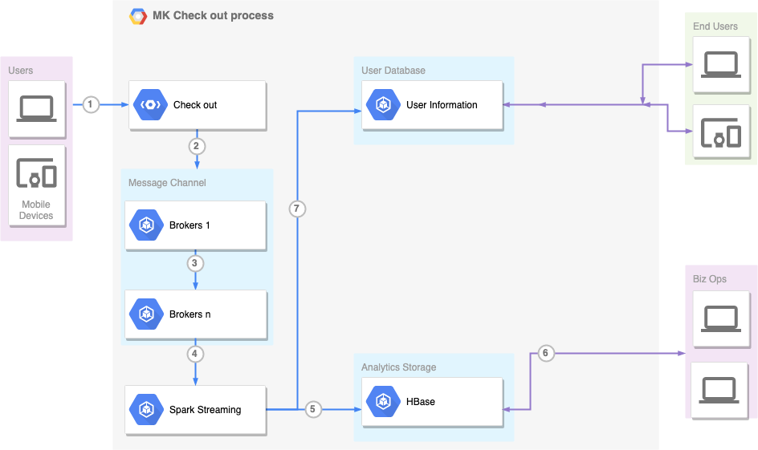
Business Scenario
Ecommerce Platform
Users checkout their carts
The system send to brokers the cart, shipping information and more
The system will digest the data, and save to the NoSQL data store for analytics later
The buyer/biz ops can see the insightful data visualization to make their decisions betters

Slide 4
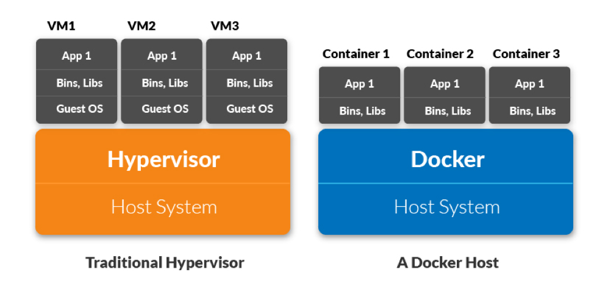
Containerized services
Centralized and Decentralized
Lightweight solution, easy to scale
Containerized solution makes Dev Ops life easier
Microservice solution based
Docker and Kubernetes are the new good friends!

Slide 5
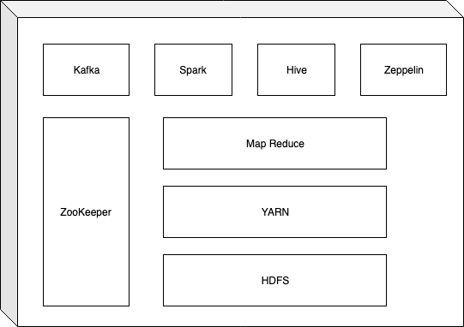
From monolithic …

Slide 6
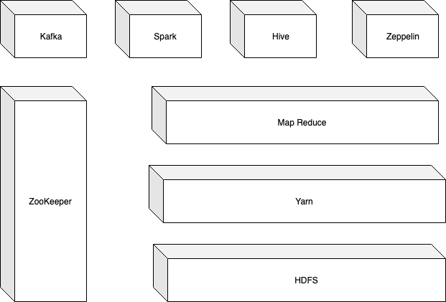
… To Micro service approach

Slide 7





Data flow
Storages
?
Message Queue
(Kafka, RabbitMQ …)
Stream processing
(Spark, KSQL)
E-commerce, Mortgage, ERP …
Data visualization: Zeppelin, Tableau, Jupyter, Plotly, Kibana …

Slide 8
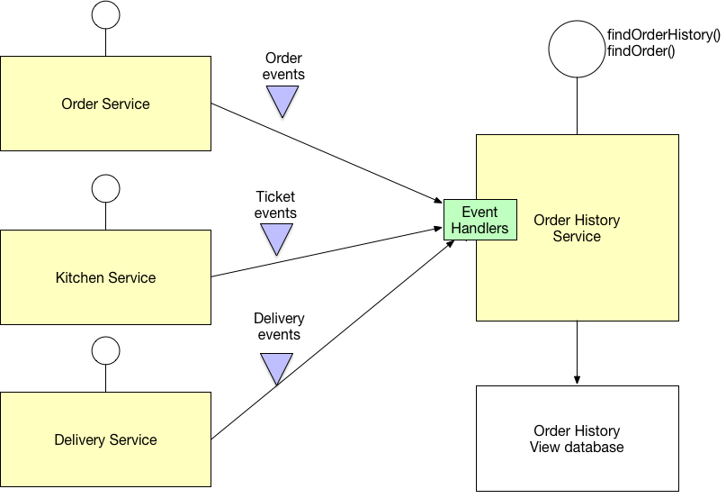
Command Query Responsibility Segregation (CQRS)

Slide 9
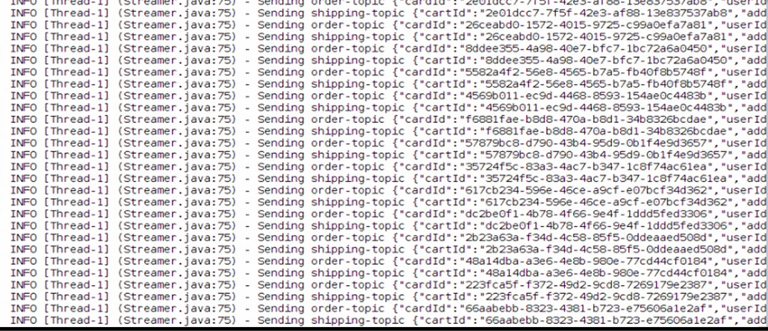
Asynchronous with MQ
while(!shutdown) { val cart = CartDB.randomCart(timeRange) streamer.sendCart(cart, …………) val shipping = ShippingDB.randomShipping(cart) streamer.sendShipping(shipping, ………)
// keep doing other job }
Cart topic
shipping topic
E-commerce simulator
Kafka

Slide 10
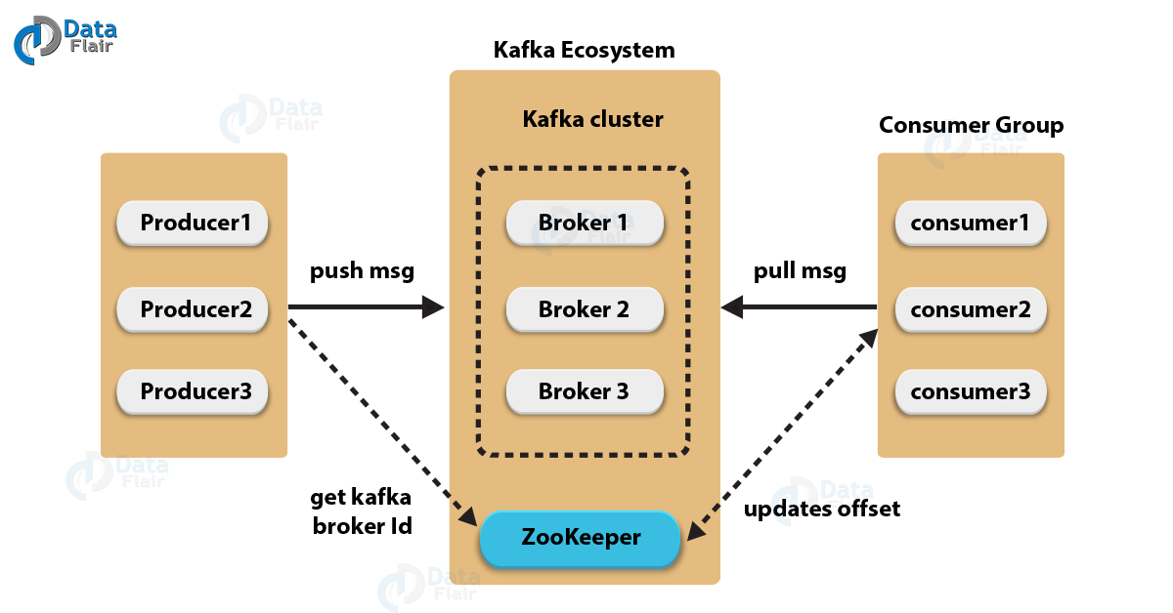
Kafka Introduction

Slide 11
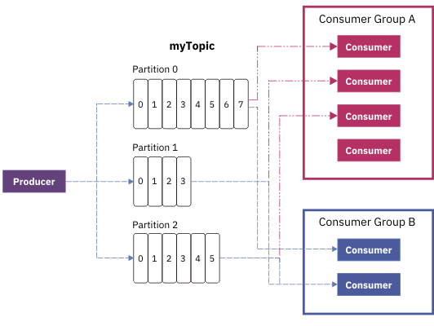
Kafka Introduction

Slide 12
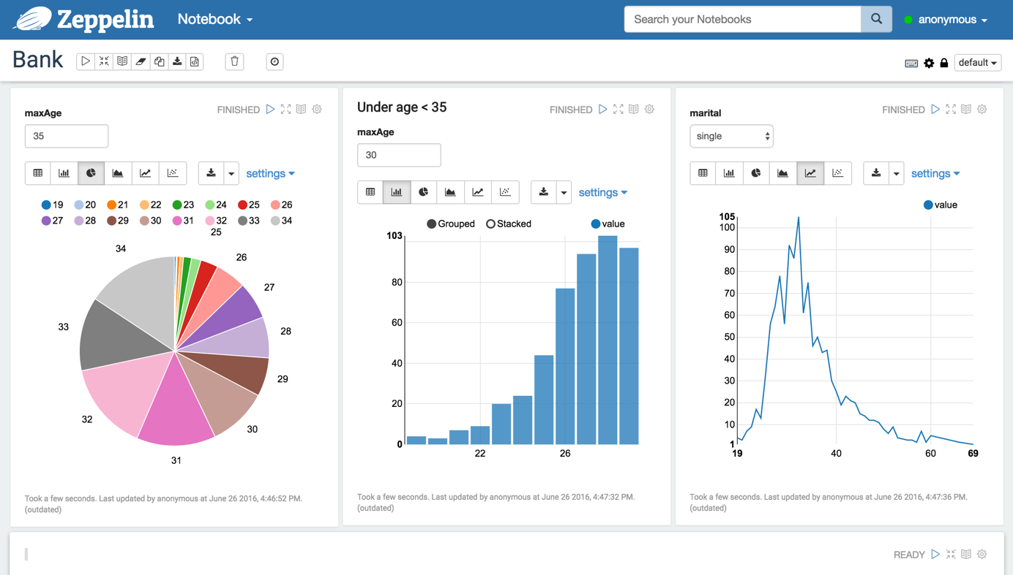
Zeppelin Introduction
Web-based UI (localhost:8080 by default)
Code section
Commands
Report section
Multiple paragraphs

Slide 13
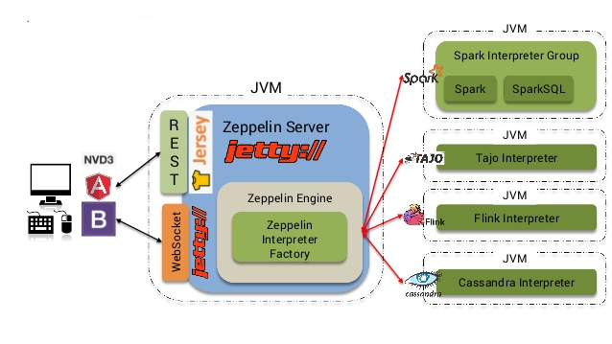
Zeppelin Introduction

Slide 14
Demo

Slide 15
What we learn from this project
Google and Stackoverflow are my best friends
Big Data requires a ‘big’ of memory
There are a lot of room for the improvements
Too big to be managable

Slide 16
Thank You.
MK
DATA WAREHOUSE SOLUTION

